Slide 1
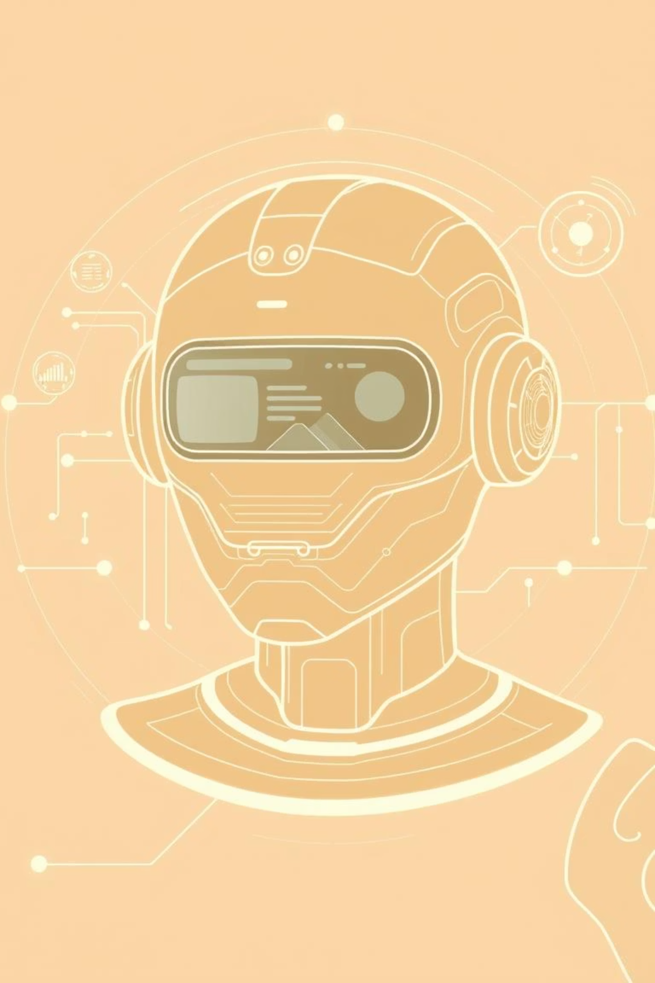
Agentic RAG Chatbot For Multi-Format Document QA Using MCP
A multi-turn document question-answering system supporting PDF, DOCX, PPTX, TXT, and CSV formats. Built using Google Gemini, FAISS, LangChain, and the Model Context Protocol (MCP).

Slide 2




🧠 Modular Agent Architecture
IngestionAgent
RetrievalAgent
Parses text and images from documents using PyMuPDF, python-docx, pptx, and OCR.
Searches for relevant chunks using FAISS vector store with OpenAI or SBERT embeddings.
LLMResponseAgent
MCP Protocol
Uses Google Gemini Pro via LangChain to generate answers.
Enables message passing between agents for multi-turn dialogue handling.

Slide 3
End to End System flow with MCP Message
User UI to upload document
Ingestion agent
parser and preprocess the data/text
Sentence Transformer
(generates the embeddings)
FAISS Store
Which stores the embeddings
MCP message
LLM RESPONSE
(Generates the output)
Retrieval agent
(gets the info from vector database)
Output and Source chunks

Slide 4
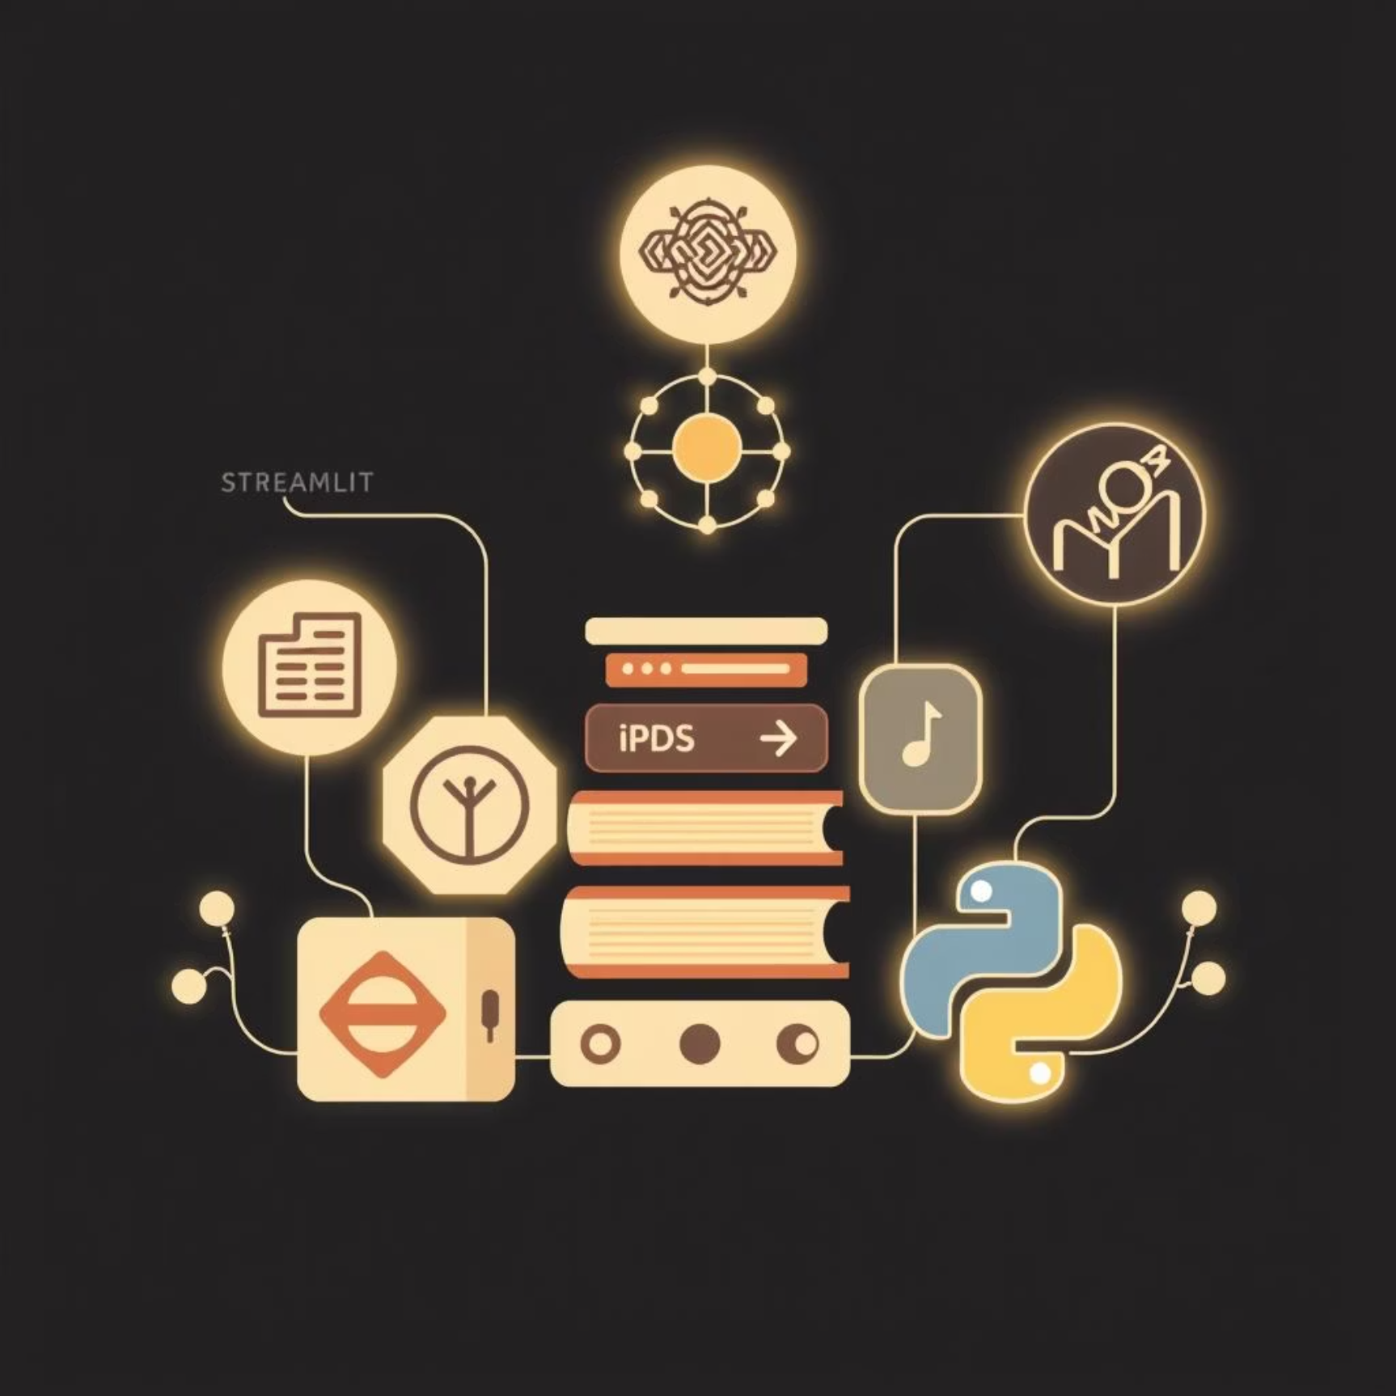
Tech Stack
Frontend:
Streamlit (UI, File Upload, Interaction)
Backend:
LangChain (Agent Management, Prompt Handling)
Google Gemini Pro (LLM API)
FAISS (Vector Similarity Search)
PyMuPDF, python-docx, pptx (Parsing)
pytesseract + Pillow (OCR)
Infrastructure:
Python 3.10+, pip virtual environment
MCP (Custom Protocol)

Slide 5
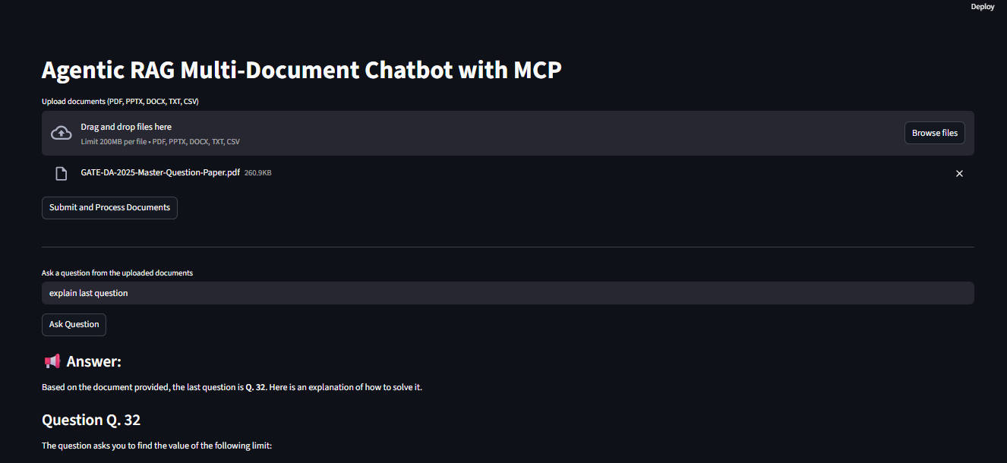
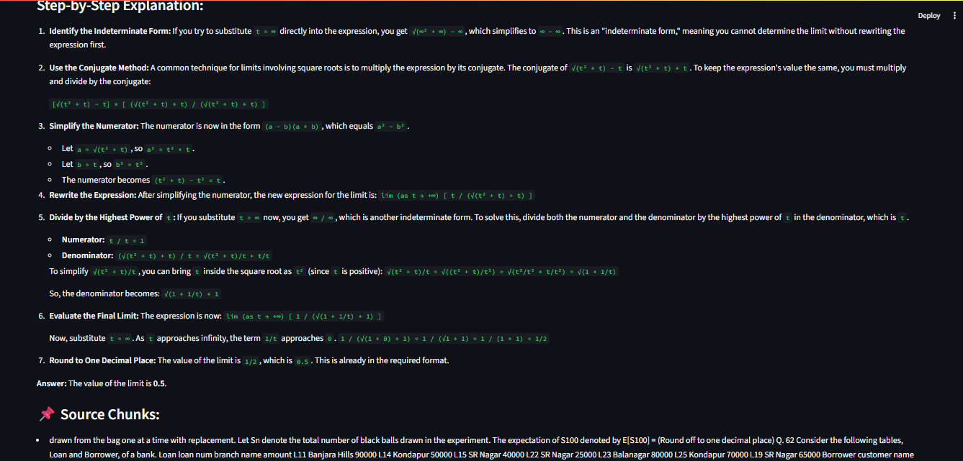
UI Screenshots

Slide 6
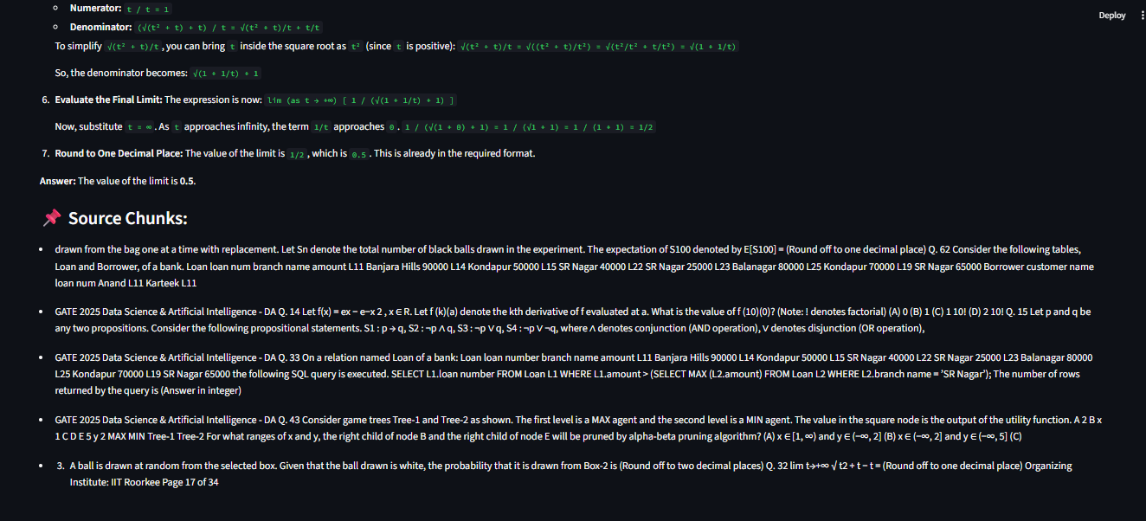

Slide 7
Challenges Faced
Technical Hurdles:
Installing & configuring OCR tools
Handling token length limits
Embedding mismatches
with Gemini
(cosine vs Euclidean)
(Tesseract, Poppler)
Multi-turn context management
Inference errors and fallback strategies

Slide 8
Future Scope & Improvements
🔮 What’s Next?
Multi-language OCR support
(Hindi, Telugu, etc.)
UI-based conversation history saving
Source highlighting for citations
Fallback model with GPT-4 when Gemini fails
Deploy on cloud (GCP/AWS) with GPU acceleration

Slide 9
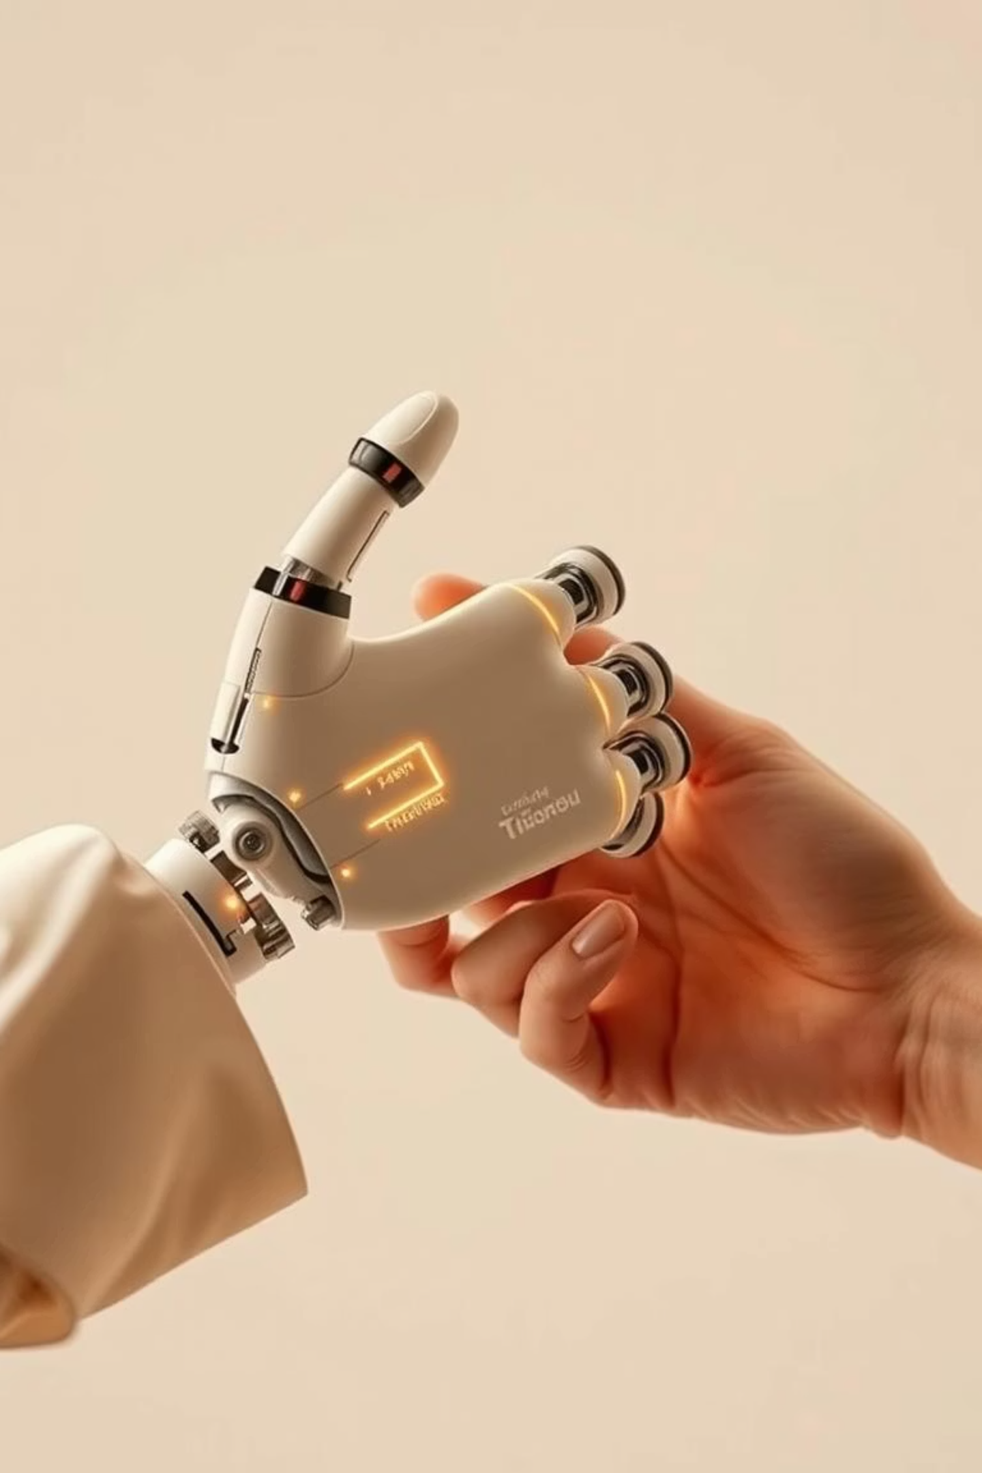
Thank You!
Thank you for joining our presentation on the Agentic RAG Chatbot. We appreciate your time and interest!

